Slide 1
Management of type 2 diabetes during Ramadan
Prof. Quazi Tarikul Islam
FCPS, FACP, FRCP
Professor of Medicine
Dhaka Medical College & Hospital

Slide 2

Global situation of Diabetes Mellitus
The number of people with type 2 diabetes around the world is estimated to rise from 151 million in 2000 to 300 million by 2025. The recognition that strict glycaemic control can reduce microvascular complications has made the effective treatment of hyperglycaemia a priority.
Ref. BMJ Vol333 Dec 9, 2006
US Focus-it strikes 16 million Americans
ARE YOU AT RISK?

Slide 3
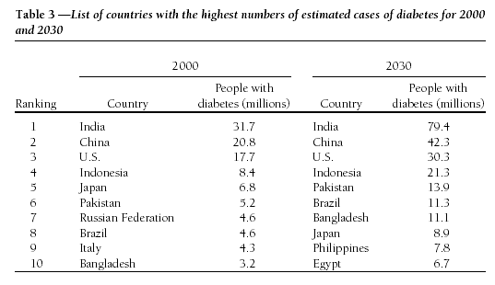
List of Countries with the highest numbers of estimated cases of diabetes for 2000 and 2030
Ref. Diabetes Care Volume 27 Number 05 May 2004

Slide 4
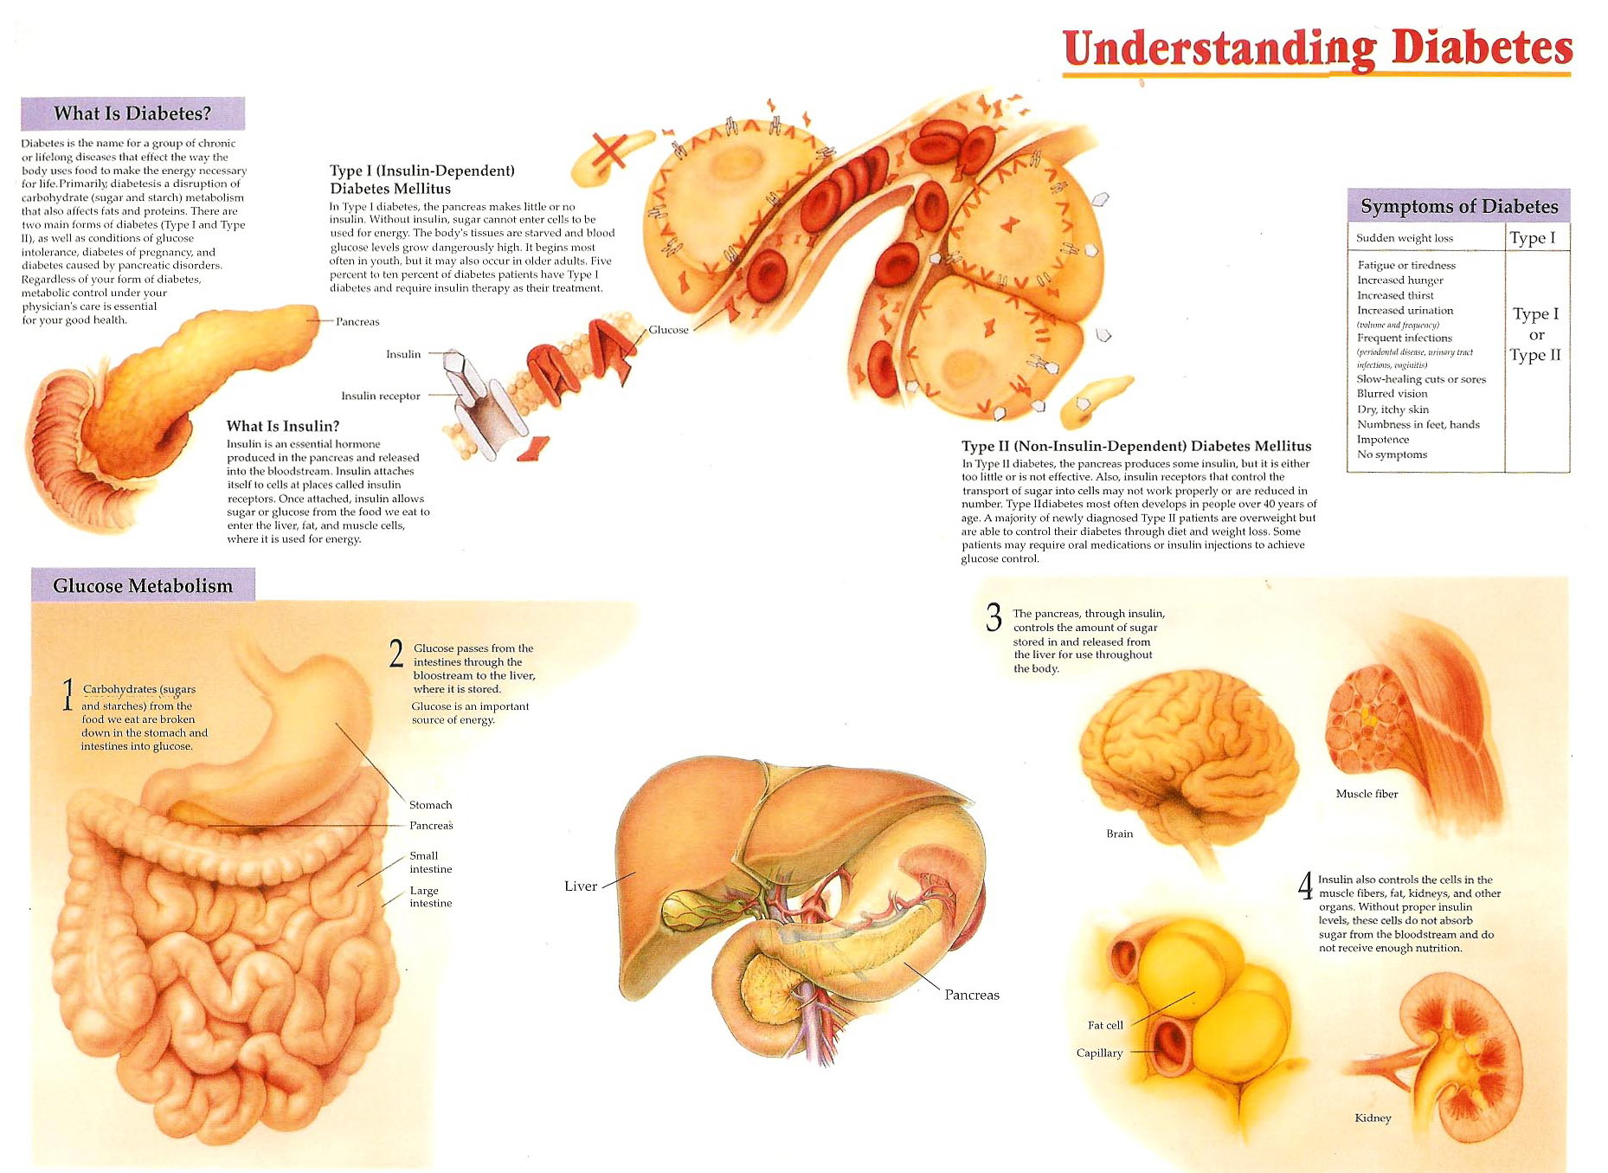

Slide 5
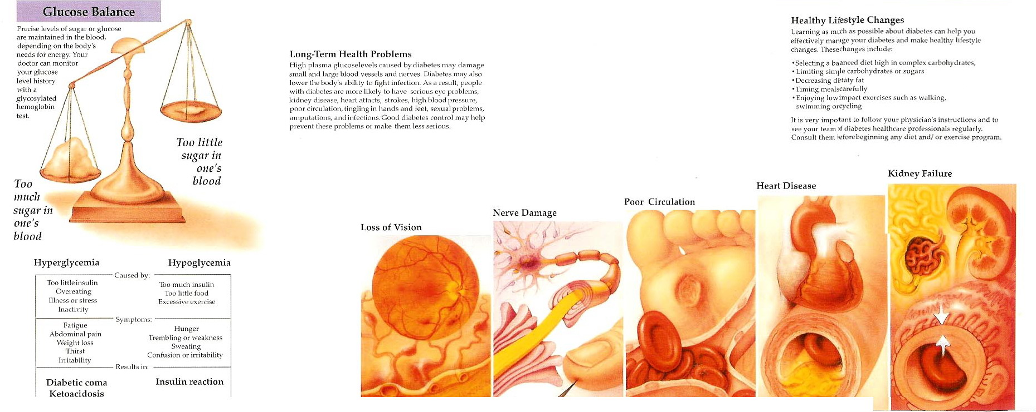

Slide 6
Type 2 Diabetes: A Dual Defect Disease
Genes
Genes
Impaired Insulin
Secretion
Insulin
Resistance
± Environment
IGT
IGT
Type 2 Diabetes
IGT = Impaired Glucose Tolerance
Notes:
Developed by Derek Le Roith, M.D., Ph.D.
Aventis Dinner 2000
Slide 3
Type 2 Diabetes:
Two Defects
The pathophysiology of type 2 diabetes mellitus is related to two defects. The clinical expression of this disease usually requires the presence of both impaired insulin secretion and insulin resistance. These traits are thought to be genetically determined although the genes have not yet been identified. Environmental factors, such as obesity, a high-fat diet, physical inactivity, or some medications, usually participate in the expression of these traits. Individuals with one genetic defect, with or without an environmental trigger, may demonstrate impaired glucose tolerance or impaired fasting glucose but do not typically develop frank diabetes. In most instances, both β-cell dysfunction and insulin resistance are required for the development of the hyperglycemia of type 2 diabetes.

Slide 7
Course of Type 2 Diabetes
Obesity
IFG*
Diabetes
Uncontrolled
Hyperglycemia
350 –
300 –
Postmeal Glucose
Glucose
(mg/dL)
250 –
200 –
Fasting Glucose
150 –
100 –
50 –
250 –
Relative
Function
(%)
200 –
Insulin Resistance
150 –
100 –
50 –
β-cell Failure
0 –
-10
-5
0
5
10
15
20
25
30
Years of Diabetes
Notes:
7

Slide 8
Grading of type 2 diabetes
Category Fasting (basal) plasma
glucose level (mg/dL)*
Mild <140
Moderate 140-250
Severe >250
Very severe >250-300
Notes:
Hyperglycemia
The Defining Feature of Diabetes
KEY POINTS
• Persistent hyperglycemia is the hallmark of all forms of diabetes
• Hyperglycemia results from excessive hepatic glucose production as
well as from impaired glucose clearance caused by defects in insulin
secretion, insulin action, or both
• Chronic hyperglycemia causes long-term tissue damage in organs
throughout the body
Diabetes mellitus is a group of complex metabolic disorders marked by
persistent hyperglycemia. Hyperglycemia results from excessive glucose
production by the liver as well as from impaired glucose clearance due
to defects in insulin secretion, insulin action, or both.1
The chronic hyperglycemia of diabetes is associated with long-term tissue
damage involving various organs in the body, most notably the eyes, kidneys,
nerves, heart, and blood vessels.1

Slide 9
AGENDA
Physiology of fasting
Fasting with type 2 diabetes and Impact
Effects of fasting on DM
Risks associated with fasting
Adjustment of diet & exercise
Blood glucose monitoring
Change of treatment regimen
Suitable OAD during Ramadan

Slide 10
Fasting with
Type 2 Diabetes

Slide 11
Surah Al-Baqarah: 183-184
…..Observing As-Saum (the fasting) is prescribed for you as it was prescribed for those before you, ….
….., but if any of you is ill or on a journey, …… And as for those who can fast with difficulty, (e.g. elderly, etc),…….
Notes:
Fasting at Ramadan is one of the five pillars of Islam
However when fasting significantly alters the health of the persons fasting or if the persons is ill, one is exempted from fasting.
Unfortunately, a significant number of sick people insist on fasting. They do not see themselves as having a desease and choose to fast.
From the point of view of Islam, this exception represent more than simple permission not to fast. This problem arises particularly for diabetic patients and it affect the ill, their families, the teologians and society to find a common solution.

Slide 12
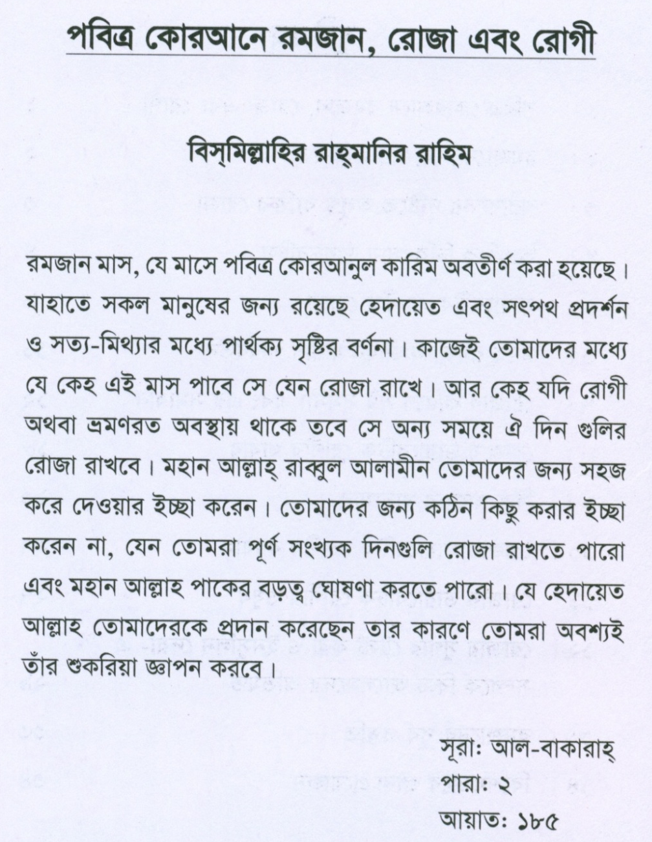
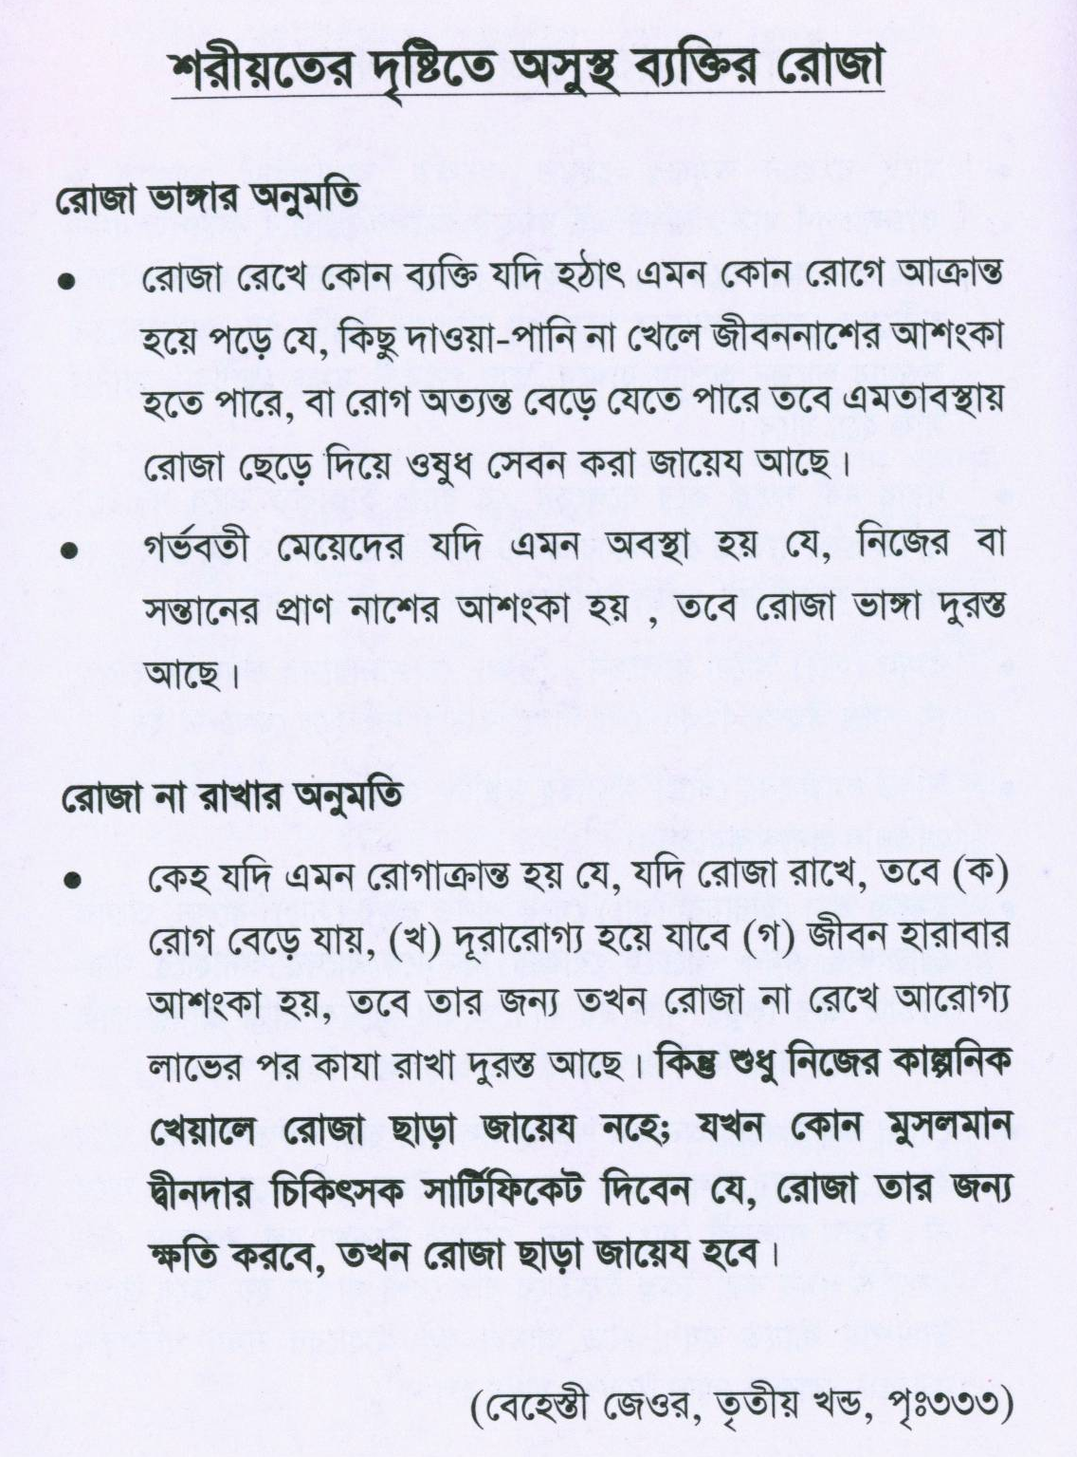

Slide 13
PHYLOSOPHY OF FASTING
During Ramadan, Muslims must fast from dawn to sunset.
Food and fluids may be consumed freely during the night, but forbidden during day time, including oral and parenteral medication.
This will involve a sudden and major change in the daily meals.
Notes:
During Ramadan, eating habits change in many ways, not only do mealtimes change, but patterns of meals, the short of food eaten and caloric intake all change in a stereotyped way.
There is an increase in post prandial physical activity during the nighttimes associated with observation of religious practices (Tarawih).
Psychological changes due to the general spiritual atmosphere during Ramadan, which create a feeling of inner well-being, are also important.

Slide 14
This include meal timing, total calories, food type and consistency.
Prior to the month of Ramadan, people usually take 3 major meals (breakfast, lunch, dinner/supper)
This will change to only two meal named Iftar and Sahr. Iftar will be around 7:00 pm and Sahr will be around 3:30 am.

Slide 15
Physiological State of Healthy Individuals During Ramadan (Kuwait study) (1)
Body weight decrease transiently during the first half of Ramadan, but recovered by the end.
Respiratory and cardiovascular parameters during exercise were perturbed.
Plasma osmolarity and protein concentration were increased during Ramadan, maybe an indication of dehydration.

Slide 16
Physiological State of Healthy Individuals During Ramadan (2)
Increases in acid and pepsin secretion were noted with no changes in plasma gastrin, mucogastrin, or the duodeno-gastric reflex. (Moroccan study)
Decrease in fasting plasma glucose and insulin. Increase in plasma proteins. Lipid parameters were not altered. (Tunisian study)

Slide 17
What Happenes During Ramadan ?
Eating habits change in many ways, not only do mealtimes change, but patterns of meals, the sort of food eaten and caloric intake all change in a stereotyped way.
Increased in post prandial physical activity during the nighttimes associated with Tarawih.
Psychological changes due to the general spiritual atmosphere during Ramadan, which create a feeling of inner well-being
Notes:
During Ramadan, eating habits change in many ways, not only do mealtimes change, but patterns of meals, the short of food eaten and caloric intake all change in a stereotyped way.
There is an increase in post prandial physical activity during the nighttimes associated with observation of religious practices (Tarawih).
Psychological changes due to the general spiritual atmosphere during Ramadan, which create a feeling of inner well-being, are also important.

Slide 18
Impact of Fasting in Diabetics During Ramadan
Blood glucose levels → triggered homeostatic mechanism to prevent hypoglycemia. But in diabetics, this mechanism can be disrupted, and also perturbed by medication.
Risk of hypoglycemia during daytime and hyperglycemia following Iftar are 6 % and 3 % respectively.
Changes in timing medication are important.
Notes:
Blood glucose levels fall during fasting, which triggers a homeostatic mechanism to prevent hypoglycemia, but in diabetic patient, the mechanism can be disrupted, and also perturbed by medication which increase glucose uptake or utilization.
There is a risk of hypoglycemia during daytime (may occur in 6% patients) and of hyperglycemia following If tar (occur in 3% patients).
Changes in timing medication are important.

Slide 19
Impact of Fasting in Diabetics During Ramadan
If a proper medication regimen is followed, stable and uncomplicated patients on OHA should be able to fast without problems.
Patients taking single dose insulin or combination therapy may be able to fast but needs to be evaluated on an individual basis.

Slide 20
Impact of Fasting in Diabetics During Ramadan
In the fasting state, individual depends totally on endogenous substrates for energy.
Fasting subject is considered in a state of catabolism since his source of energy are all decreasing.
The liver supplies glucose by glycogenolysis.

Slide 21
Impact of Fasting in Diabetics During Ramadan
Glucose oxidation in liver and muscles is spared as soon as increased quantities of FFA becomes available.
A balance is reached at a plasma glucose level sufficient to ensure adequate brain function and at insulin and glucagon levels sufficient to prevent excessive depletion of previously stored nutrients.
Notes:
Glucose oxidation in liver and muscles is spared as soon as increased quantities of FFA becomes available.
At any point during Ramadan fast, a balance is reached at a plasma glucose level sufficient to ensure adequate brain function and at insulin and glucagon levels sufficient to prevent excessive depletion of previously stored nutrients.

Slide 22
Effect on Diabetic Controlled During Ramadan Fasting
Observational study
N=60 (30 males and 30 females)
Well controlled type 2 diabetics treated with OHA (PPG < 200 mg%)
Mean body weight 0,75 Kg
Mean Post Prandial Glucose 9,32 mg%
No correlation from both parameters.
Askandar T etal, Kopapdi V,1978.

Slide 23
Effect of Ramadan Fasting on Well Controlled Diabetic Patients
Observational study
Well controlled diabetics with out severe complication
N=55; 49 on diet and 6 on diet +OHA
No Changes in BW, BG and lipid profile
There is no negative effects of fasting during Ramadan, as long as they followed the instructions.
Manaf A. etal, Kopapdi V, 1981

Slide 24
Blood Glucose Responses Of Diabetics During the Fasting Month Ramadan
Observational study
N=22; controlled diabetic
Diet and medication were maintain
Blood glucose levels from 8 to 11 am at the first and last week of fasting month, but not from 11 am to 6 pm.
Hypoglycemia should be anticipated when good controlled diabetics are going to fast.
Soegondo S etal, AOCE

Slide 25
Observational study
N=41 type 2 diabetics (9 on diet, 12 on single OHA, and 20 on combined OHA)
Number of symptomatic hypoglycemic periods, which were not biochemically verified, increased in eight of patients (19,5%) during Ramadan. None of the patients, however, experienced severe hypoglycemia or neuroglycopenic symptoms
Ali Riza etal, Univ of Ankara

Slide 26
Ali Riza etal, Univ of Ankara
In conclusion:
type 2 diabetic is not a contraindication to fasting in Ramadan
Patients on single or combination OHA could observe Ramadan fasting with appropriate instruction about meals and OHA use.
However some patients may still experience an increased number of hypoglycemic episodes

Slide 27
Mafauzy et al., 1990
An Observational Survey of the Impact of Ramadan fasting on Diabetes
N=22; carried out in Malaysia.
No evidence of hypoglycemia was obtained.
Total caloric and carbohydrate intake both during Ramadan compared with Shaban, although the proportion of simple carbohydrate consumed from 8,4% to 14%
No changes in FBG or cholesterol level.
But fructosamine level from 6.6 to 4.3 mM.

Slide 28
Diabetic Patients other than the followings can fast
Conditions related to diabetes:
- Advanced nephropathy
- Severe retinopathy
- Autonomic neuropathy
- Hypoglycemic unawareness
- Major macrovascular diseases
- Recent hyper-osmolar state or DKA
- Poorly controlled diabetes (Mean RBG> 300)
- Multiple insulin injections per day
Physiological conditions:
- Pregnancy
- Lactation

Slide 29
Diabetic Patients other than the followings can fast
Co-existing major medical conditions such as:
- Acute peptic ulcer
- Pulmonary Tuberculosis
- Severe infection
- Severe bronchial asthma
- Recurrent stones formation
- Cancer with poor general condition
- Overt cardiovascular diseases (Recent MI)
- Severe psychiatric conditions
- Hepatic dysfunction (liver enzymes > 2 × ULN)

Slide 30


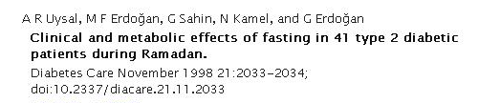
There was no significant change in body weight, BMI , total cholesterol and LDL level
There was significant increase in HDL cholesterol and significant decrease in TG level
Fasting along with regular prayer have been proved to aid in better control of diabetes
Conclusion: Fasting during Ramadan is generally safe in type 2 diabetes
Ref: DIABETES CARE, VOLUME 21, NUMBER 11, NOVEMBER 1998

Slide 31
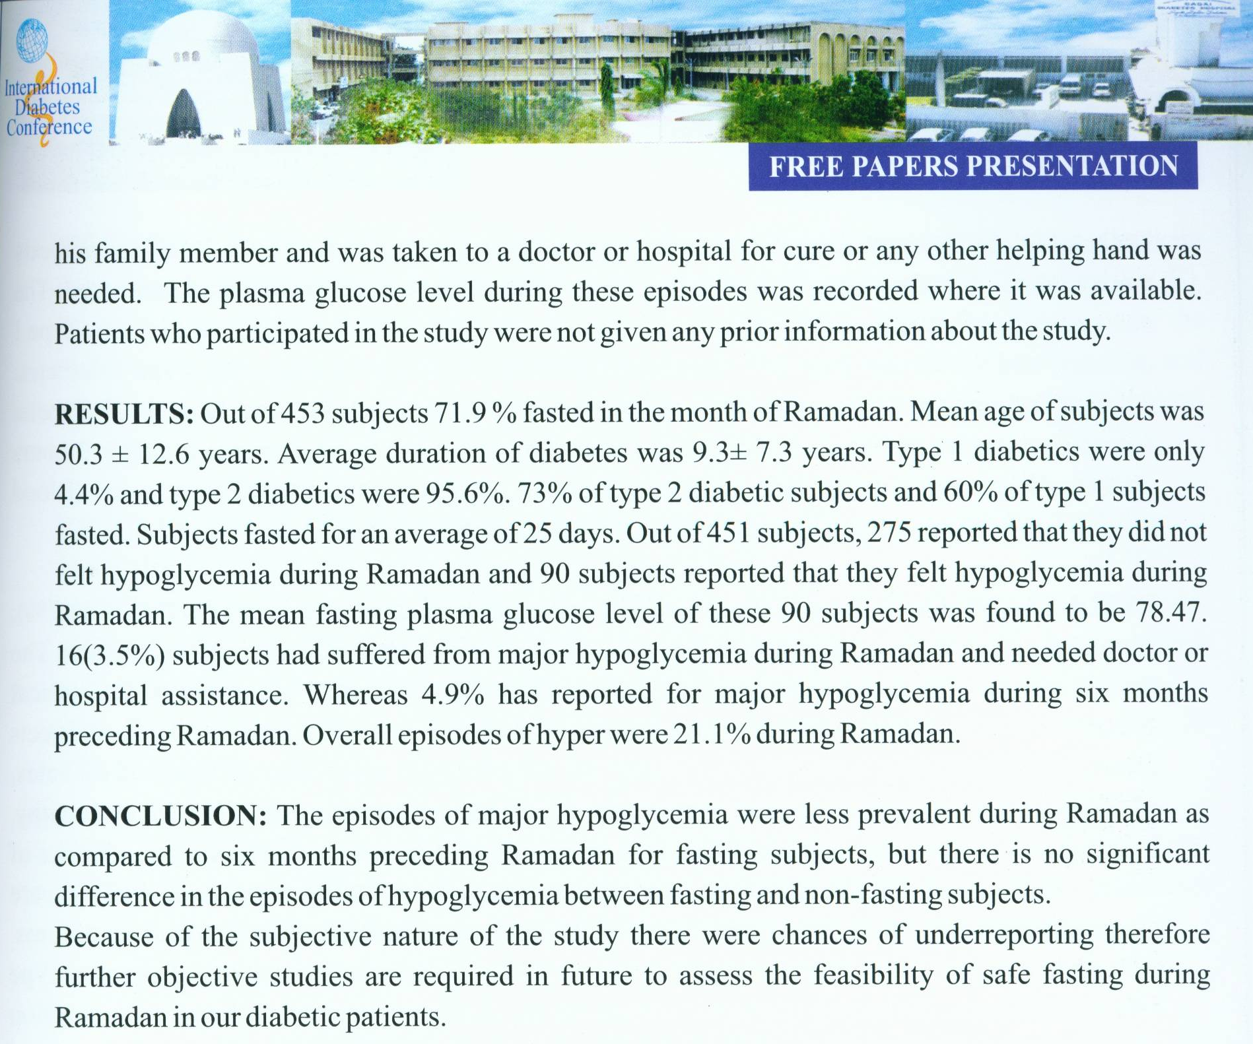
Fasting during Ramadan is safe in type 2 diabetes

Slide 32
Risks associated with fasting

Slide 33
Major risks associated with fasting in patients with diabetes
Hypoglycemia
Hyperglycemia
Dehydration
DIABETES CARE, VOLUME 28, NUMBER 9 SEPTEMBER 2005

Slide 34
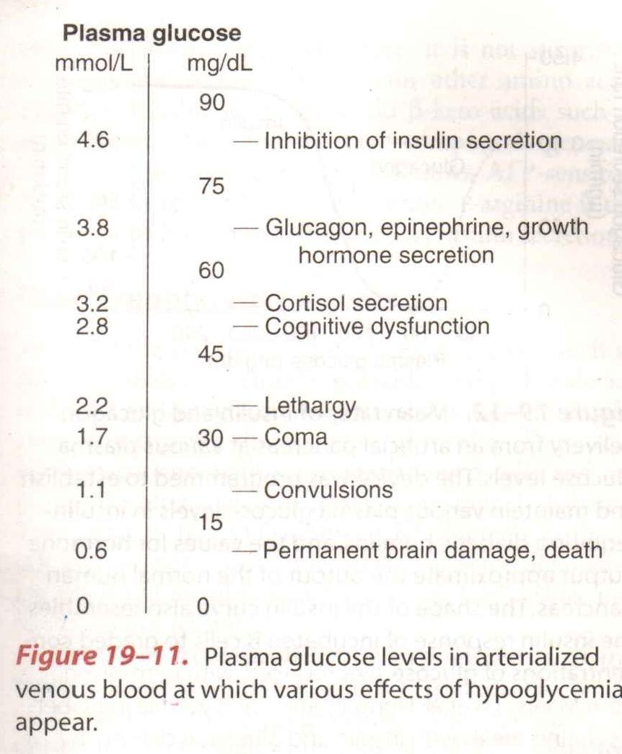
Effects of hypoglycemia in different plasma glucose level

Slide 35
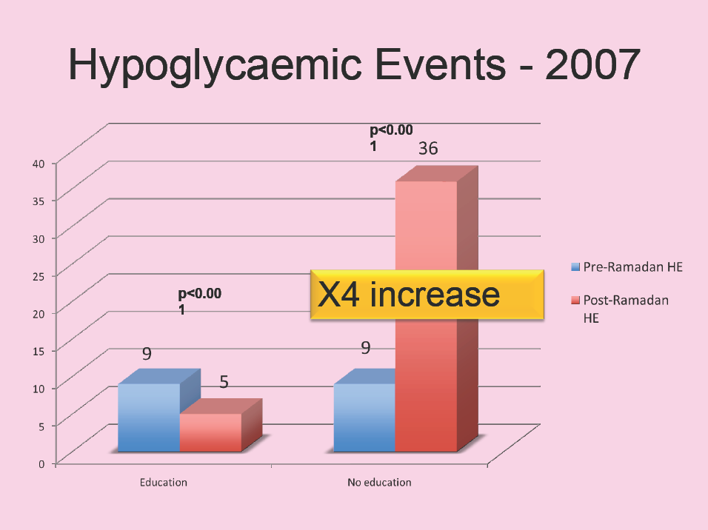
Notes:
35

Slide 36
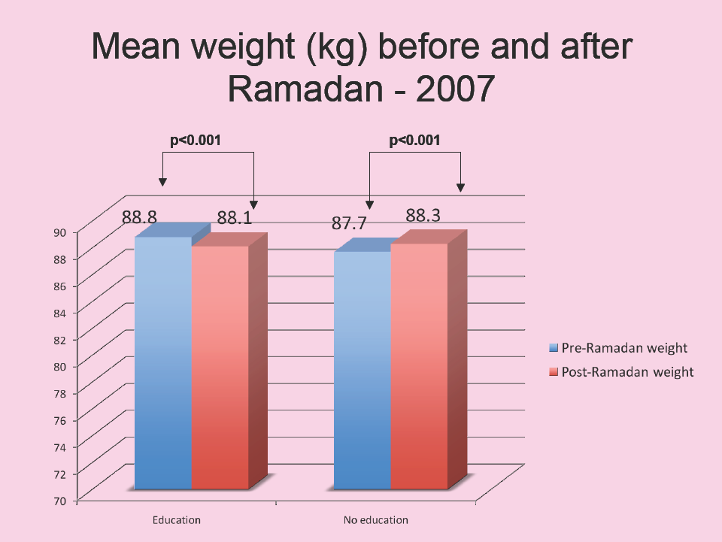
Notes:
36

Slide 37
Adjustment of diet & exercise

Slide 38
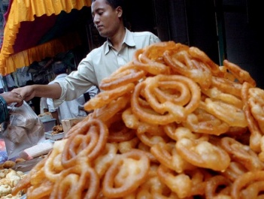
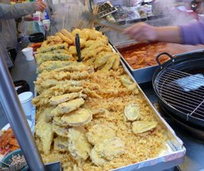

Dietary Adjustment
Keep same calorie as before Ramadan
Change schedule, amount & composition of meal
Better to consult with a nutritionist before Ramadan
Drink more water
Avoid sugar (sweetener can be used)
Avoid foods rich in fat
Avoid heavy Iftar & light Sahr
Take foods with complex carbohydrate at Sahr
Take Sahr as late as possible

Slide 39
Exercise in Ramadan
Physical activity should be reduced during day time
Exercise can be performed for an hour after Iftar
Increased prayer during Ramadan should be taken into account

Slide 40
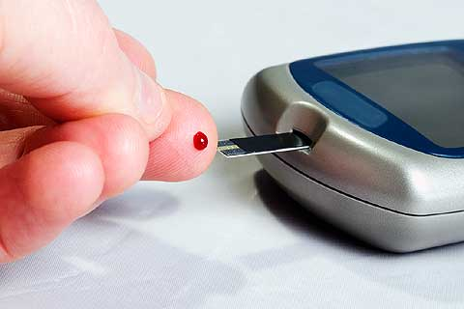
Blood glucose monitoring during Ramadan

Slide 41
Blood Glucose Monitoring
Patients should monitor their blood glucose even during fasting to recognize hypo and hyperglycemia
2 hours post sahr and one hour pre iftar are likely to pick sub-clinical hypoglycemia
1-2 hours post iftar is likely to pick sub-clinical hyperglycemia
If blood glucose is noted to be low (<60md/dL), the fast must be broken
If blood glucose is noted to be (>300mg/dL), ketones in urine should be checked and medical advice sought

Slide 42
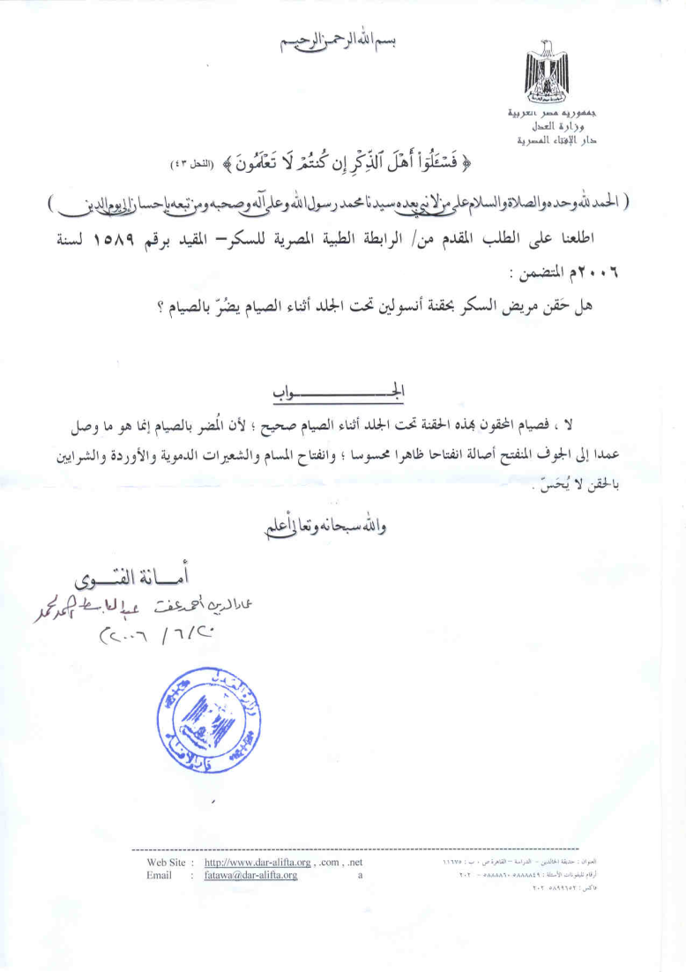
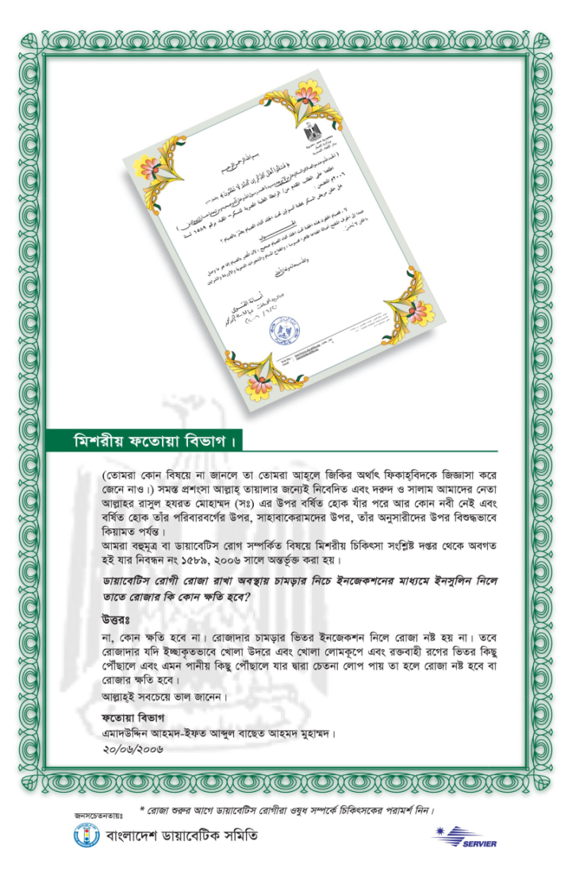
Islam permits blood glucose test while fasting

Slide 43

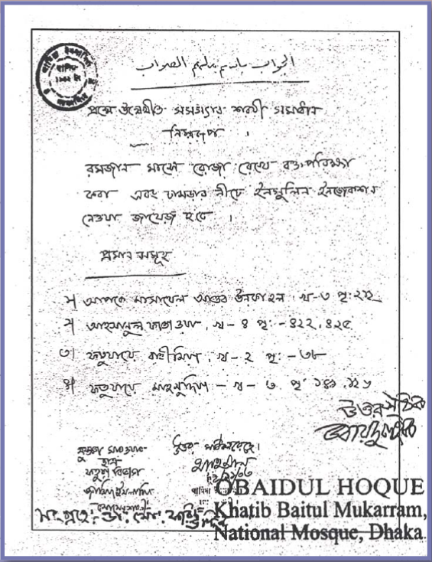
Islam permits blood glucose monitoring
even during fasting at Ramadan

Slide 44
Change of
treatment regimen

Slide 45
Treatment Recommendations
Before Ramadan
During Ramadan
Patients on diet and exercise control
No change is needed (modify time and intensity of exercise), ensure adequate fluid intake
Patients on oral hypoglycemic agents
Sulfonylureas once daily,
Dose should be taken at Iftar
Sulfonylureas twice daily,
e.g., gliclazide 80mg/ glibenclamide 5mg
Full morning dose at Iftar and half of the usual evening dose at Suhur
Biguanide,
e.g., Metformin 500 mg thrice daily
Metformin, 1,000 mg at Iftar, 500 mg at Sahr

Slide 46
Treatment Recommendations
Before Ramadan
During Ramadan
Thiazolidinedione
No change is needed
Repaglinide & Natiglinide
Should be used as usual
Patients on insulin
e.g., 70/30 premixed insulin twice daily
30 units in morning and 20 units in evening
Use the usual morning dose at Iftar and half of the usual evening dose at Sahr.
e.g., 70/30 premixed insulin,
30 units in evening and 10 units in morning; also consider changing to insulin analogue

Slide 47
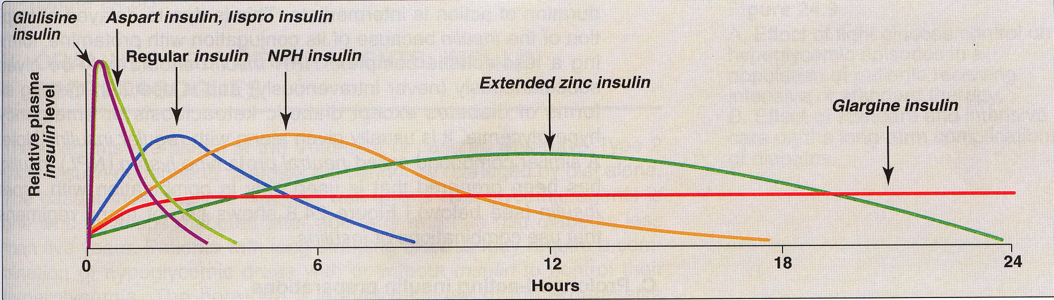

Slide 48
Suitable OAD during Ramadan

Slide 49
Sulphonylureas in the management of type 2 diabetes during the fasting month of Ramadan
Many of Muslim type 2 diabetic patients fast in Ramadan
Alteration of energy intake, physical activity & drug pattern associated with greater risk of hypoglycemia & ketoacidosis
Sulphonylureas as a first line used by majority of patients
Among the Sulphonylureas comparing efficacy and safety; gliclazide MR taken in the evening may be the Sulphonylurea of choice during Ramadan

Slide 50
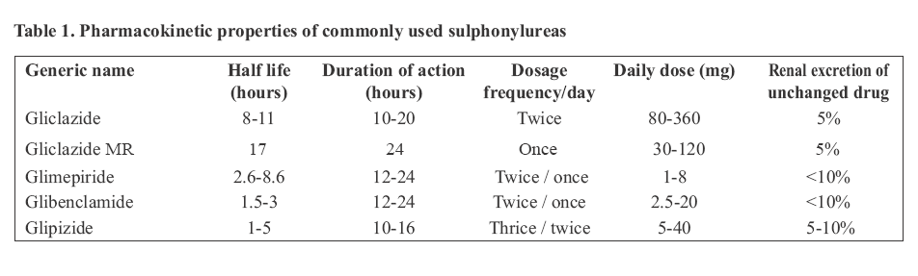
SU with short half life & multiple dosage are not suitable in Ramadan to achieve 24 hr plasma distribution

Slide 51
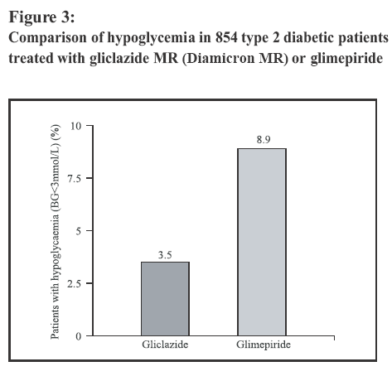
Among the two once daily Sulphonylureas hypoglycemia is -50% less with Gliclazide MR than glimepiride
Diamicron MR
Glimepiride

Slide 52
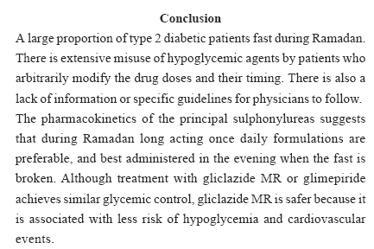
With similar glycemic control Gliclazide MR is associated with less hypo and cardiovascular events than glimepiride

Slide 53
Management of glycemic control with the evening administration of a once daily Sulfonylurea (Diamicron MR) in South Asian type 2 diabetic patients undertaking Ramadan fast
Objective:
To evaluate the efficacy & safety of Diamicron MR in type 2 diabetic patients during Ramadan at Iftar
Participating countries:
Bangladesh, India & Pakistan

Slide 54
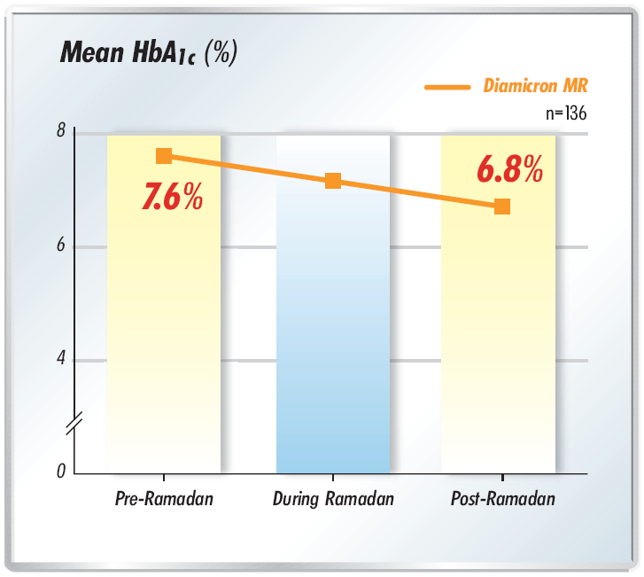
Conclusion:
Diamicron MR maintains tight glycemic control
before, during & after Ramadan

Slide 55
Recommendations on The Management of Diabetes During Ramadan
Put forward at a Consensus Meeting held in Casablanca, Morocco in 1995
These covered:
  criteria allowing for or exempting from fasting and recommendations for monitoring.
  Other topic covered included community education programmers, treatment regimens
  methodology and content for the future research programs

Slide 56
CURRENT RECOMENDATIONS
Permitted to fasting :
Type 2 patients treated with biguanides or sulphonyureas, who are stable and do not have any complicating progressive co-morbid pathology.
Exempted from fasting :
Type 1, unstable disease, co-morbid degenerative disease, pregnancy, elderly.

Slide 57
CURRENT RECOMENDATIONS
Monitoring was recommended before, during and after Ramadan, include diabetic symptoms and glucose control, psycho- logical state and co morbidity.
Education programs directed at patients and their families. should focus on condition in which fasting is contraindicated, modifying the regimen, dietary considerations, and the importance of monitoring.

Slide 58
Lifestyle
Ramadan provides and excellent opportunity to initiate healthy lifestyle changes.
Motivation for self improvement is high at this time of year, the switch in eating pattern breaks previous habits, and weight lose goals
Meals time should be fixed, with the principal meal in the evening, and the lesser meal before sunrise.

Slide 59
Lifestyle
Patient should be encouraged to eat a proper meal.
Eating snacks between two meals should be avoided
Ensure that an appropriate level of physical activity is maintained, whether formal exercise programs or associated with fulfilling religious obligations.

Slide 60
IN CONCLUSION
Uncomplicated type 2 diabetic patients can fast safely during Ramadan
Pre-Ramadan counseling is very important to prevent diabetic complications during fasting
Fasting along with regular prayer have been proved to aid in better control of diabetes
Selection of suitable OAD and BG monitoring can significantly reduce risks associated with fasting
As per clinical evidences Gliclazide MR maintains tight glycemic control, safely during Ramadan

Slide 61

THANK YOU

